Slide 1

Chapter 6: Fig 6.40 Switch Statement

Slide 2
The Switch Statement fig. 6.40
#include <stdio.h>
int main( ){
int guess;
printf("Pick a number 0..3");
scanf("%d", &guess);
switch(guess){
case 0: printf("Not Close");
break;
case 1: printf("Close");
break;
case 2: printf("Right on");
break;
case 3: printf("Too High");
}
printf("\n");
return 0;
}

Slide 3
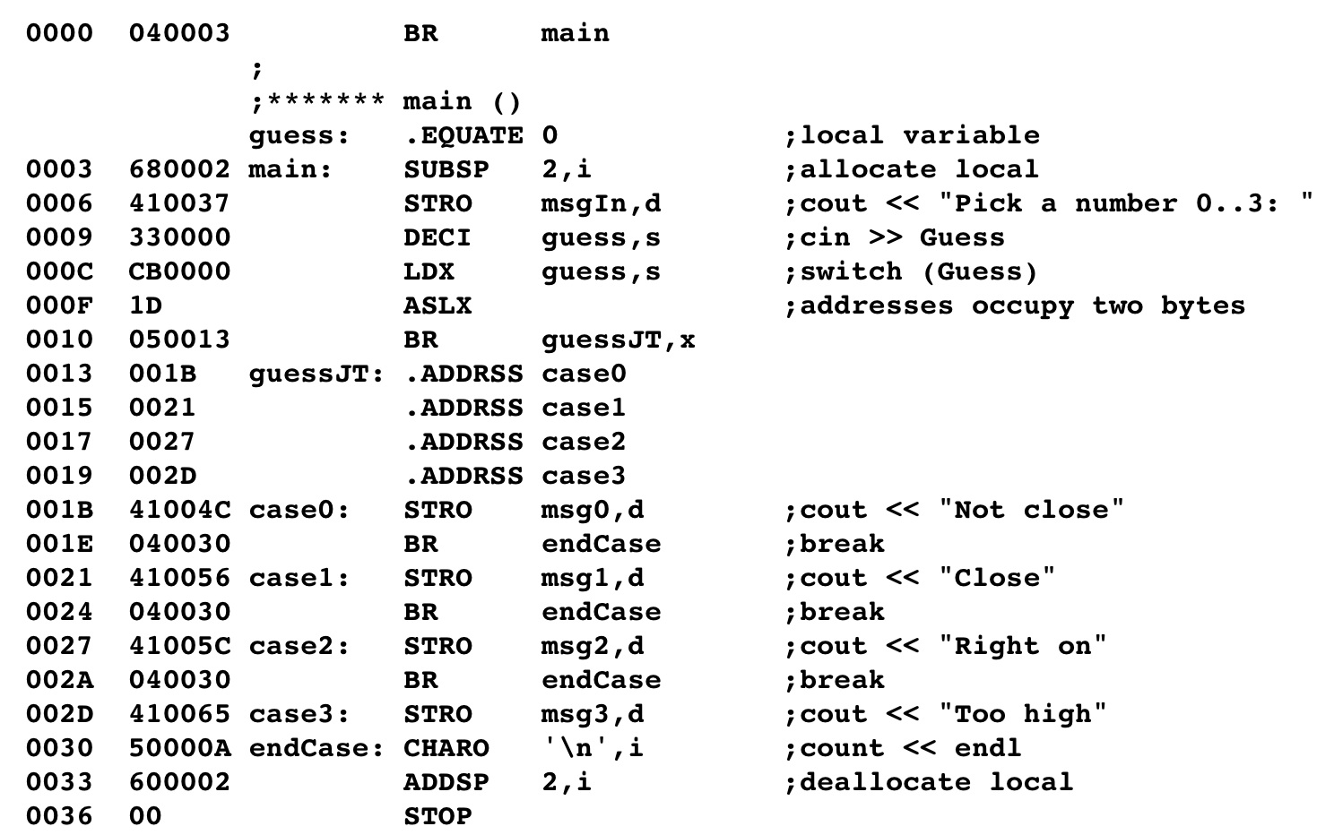
The Switch Statement
Use indexed addressing in the branch instruction
The code inserted in the machine program is the address of each of the case labels
The Jump Table

Slide 4
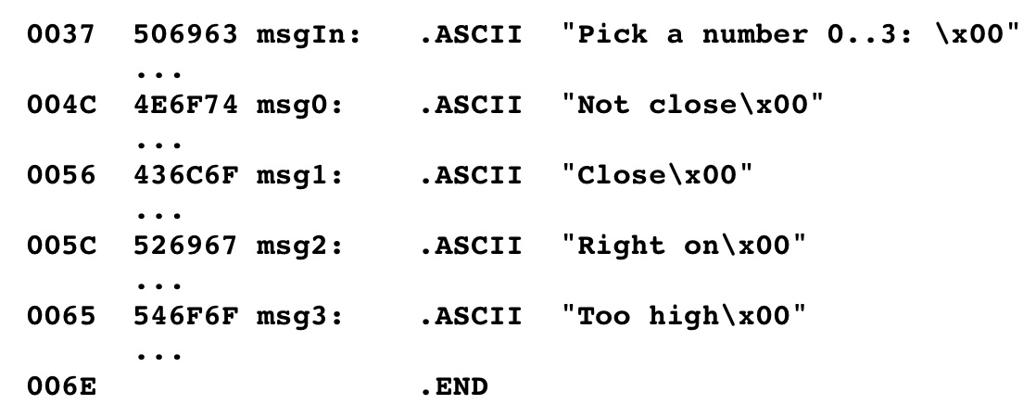
The Switch Statement

Slide 5
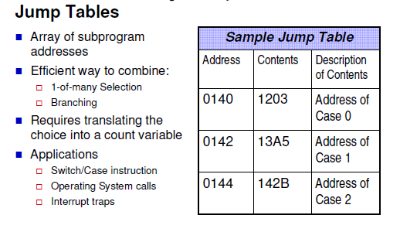
Jump Table

Slide 6
Jump Table
label | Address | Contents
 | …
guessJT: | 0013 | 00
 | 0014 | 1B
 | 0015 | 00
 | 0016 | 21
 | 0017 | 00
 | 0018 | 27
 | 0019 | 00
 | 0020 | 2D
 | …
 | FBCD
 | FBCE
 | FBCF
How it works:
Input value: 2
DECI guess, s
instruction Register
0000
Index Register
FBCD
Stack Pointer

Slide 7
Jump Table
label | Address | Contents
 | …
guessJT: | 0013 | 00
 | 0014 | 1B
 | 0015 | 00
 | 0016 | 21
 | 0017 | 00
 | 0018 | 27
 | 0019 | 00
 | 0020 | 2D
 | …
 | FBCD | 00
 | FBCE | 02
 | FBCF
How it works:
Input value: 2
DECI guess, s
instruction Register
0000
Index Register
FBCD
Stack Pointer

Slide 8
Jump Table
label | Address | Contents
 | …
guessJT: | 0013 | 00
 | 0014 | 1B
 | 0015 | 00
 | 0016 | 21
 | 0017 | 00
 | 0018 | 27
 | 0019 | 00
 | 0020 | 2D
 | …
 | FBCD | 00
 | FBCE | 02
 | FBCF
How it works:
Input value: 2
LDX guess, s
instruction Register
0002
Index Register
FBCD
Stack Pointer

Slide 9
Jump Table
label | Address | Contents
 | …
guessJT: | 0013 | 00
 | 0014 | 1B
 | 0015 | 00
 | 0016 | 21
 | 0017 | 00
 | 0018 | 27
 | 0019 | 00
 | 0020 | 2D
 | …
 | FBCD | 00
 | FBCE | 02
 | FBCF
How it works:
Input value: 2
ASLX
instruction Register
0004
Index Register
FBCD
Stack Pointer

Slide 10
Jump Table
label | Address | Contents
 | …
guessJT: | 0013 | 00
 | 0014 | 1B
 | 0015 | 00
 | 0016 | 21
 | 0017 | 00
 | 0018 | 27
 | 0019 | 00
 | 0020 | 2D
 | …
 | FBCD | 00
 | FBCE | 02
 | FBCF
How it works:
Input value: 2
BR guessJT, x
instruction Register
+
0004
Index Register
FBCD
Stack Pointer

Slide 11
Jump Table
label | Address | Contents
 | …
guessJT: | 0013 | 00
 | 0014 | 1B
 | 0015 | 00
 | 0016 | 21
 | 0017 | 00
 | 0018 | 27
 | 0019 | 00
 | 0020 | 2D
 | …
 | FBCD | 00
 | FBCE | 02
 | FBCF
How it works:
Input value: 2
BR guessJT, x
instruction Register
+
0004
Index Register
0027 Becomes the operand for the branch
FBCD
Stack Pointer

